Slide 1

DEVOPS
CI/CD Tool
Notes:
We designed this template so that each member of the project team has a set of slides with its own theme. Members, here’s how you add a new slide to just your set:
Mark where you want to add the slide: Select an existing one in the Thumbnails pane, click the New Slide button, then choose a layout. The new slide gets the same theme as the other slides in your set.
Careful! Don’t annoy your fellow presenters by accidentally changing their themes. That can happen if you choose a different theme from the Design tab, which changes all of the slides in the presentation to that look.

Slide 2
Agenda
Why Continuous Integration
Difference between CI and CD
What is Jenkins
Jenkins Master-Slave Architecture
Demo

Slide 3
Why Continuous Integration ?
Continuous Integration (CI) is the practice of automating the build and testing of code every time a change is made and committing that code back to a central repository.
Making it Easier to Fix Bugs
Improving Software Quality
Increasing Productivity

Slide 4
Difference between CI and CD
While CI is used during the build and test phase, CD is used once changes are committed. The ultimate aim of CD is to always have validated and verified code in the code repository.

Slide 5
What is Jenkins ?
Jenkins is an open source continuous integration tool written in java that allows us to automate the software development process, making sure that there is less involvement of development and operations team. It integrates different parts of the development.

Slide 6
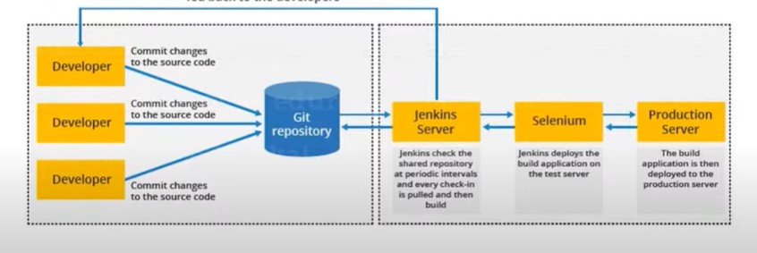
Build and test results are fed back to the developers

Slide 7
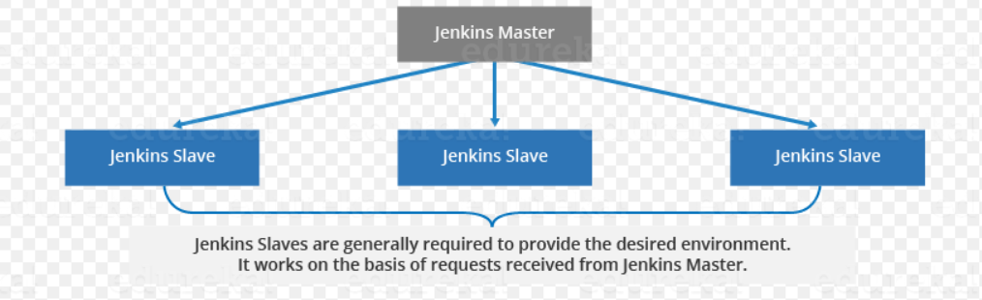
Jenkins Master-Slave Architecture
Whenever there is a change in the code, a pull happens from the Jenkins master.
The Jenkins master node distributes the jobs assigned to it to the slave nodes.

Slide 8
Demo on Jenkins
Explore the Jenkins interface
To create a job in Jenkins and finally build the Git repository through Windows batch command.

